Slide 1

The National University of Computer and Emerging Sciences
Introduction to Functions
CS 1002 Programming Fundamentals
Dr. Akhtar Jamil
Department of Computer Science

Slide 2
Goals
Review Of Previous Lecture
Introduction to Functions

Slide 3
Previous Lecture

Slide 4
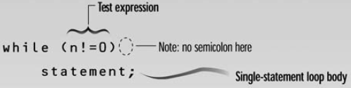
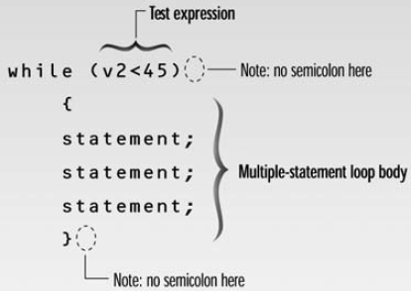
while loop - syntax
Loop body contain
single statement
Loop body contain
Multiple statement

Slide 5
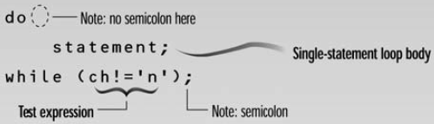
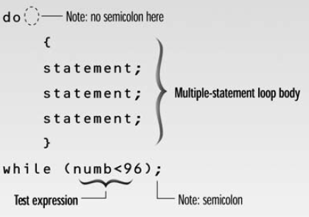
do while loop - Syntax
Loop body contain
single statement
Loop body contain
Multiple statement

Slide 6
break Statement
break statement
Immediate exit from while, for, do/while, (also used in switch)
break immediately ends the loop that contains it.
Common uses:
Escape early from a loop
Skip remainder part of the loop and exit

Slide 7
continue Statement
continue statement
Only ends the current iteration
Skips remainder of loop body (in current iteration)
Proceeds with next iteration of loop
“continue” can only be inside loops (for, while, or do-while). IT CANNOT BE USED IN “switch”

Slide 8
continue Statement - Examples
for (int i=1; i<=5; i++)
{
if (i==3)
continue;
cout<<“Hello”<<i;
}
int n;
int EvenSum=0;
while(1)
{
cin>>n;
if(n%2==1)
continue;
EvenSum = EvenSum + n;
}

Slide 9
switch statement (without break)
Suppose ch is 'a’
switch (ch) {
case 'a': cout <<“ ch contains a\n”;
case 'b': cout <<“ ch contains b\n”;
case 'c': cout <<“ ch contains c\n”;
default: cout << " Default \n";
}

Slide 10
switch statement (with break)
Suppose ch is ‘b’
switch (ch) {
case 'a': cout <<“ ch contains a\n”; break;
case 'b': cout <<“ ch contains b\n”; break;
case 'c': cout <<“ ch contains c\n”; break;
}
cout<<“\n End of program…”;

Slide 11
switch statement (with break)
Suppose ch is ‘b’
switch (ch) {
case 'a': cout <<“ ch contains a\n”; break;
case 'b': cout <<“ ch contains b\n”; break;
case 'c': cout <<“ ch contains c\n”; break;
}
cout<<“\n End of program…”;
Without the break statements, the program would execute all of the lines from the matching case statement to the end of the block.

Slide 12
Today’s Lecture

Slide 13
Functions in C++
It is better to develop and maintain large programs in the form of smaller pieces (modules)
This technique Called “Divide and Conquer”
Better Development Approach
A Development Approach
Easier To >>
Design
Debug
Extend
Modify
Understand
Reuse
main()
{
-----
----
}
function f1()
{
---
---
}
function f2()
{
---
---
}
main()
{
-----
-----
-----
-----
.
.
.
----
-----
-----
return 0;
}

Slide 14
Functions in C++(Cont.)
In C++ modules Known as Functions & Classes
Programs may use new and “prepackaged” or built-in modules
New: programmer-defined functions and classes
Prepackaged: from the standard library

Slide 15
About Functions in C++
Functions invoked by a function–call-statement which consist of it’s name and information it needs (arguments)
Example:
Boss
Main
Worker
Worker
Worker
Function Z
Function A
Function B
Sub-Worker
Sub-Worker
Note: usually main( ) Calls other functions, but other functions can call each other
Function B1
Function B2

Slide 16

Calling Function
Function calls:
Provide function name and arguments (data); Function performs operations and; Function returns results

Slide 17
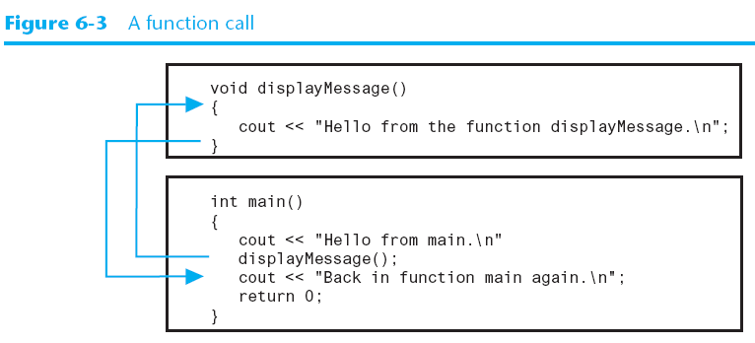
Calling Function

Slide 18
Calling Functions
Functions calling (Syntax):
<function name> (<argument list>);
e.g., FunctionName( );
FunctionName(argument1); FunctionName(argument1, argument2, …);
. . .

Slide 19
Calling Functions
Examples (built-in, and user-defined functions)
int n = getPIValue( ) ; //takes no argument
cout << sqrt(9); //takes one argument, returns square-root
cout<<pow(2,3); //calculates 2 power 3
cout<<SumValues(myArray); //returns sum of the array
A user-defined function
A user-defined function

Slide 20
Function Definition
Syntax for function definition:
returned-value-type function-name (parameter-list)
{
Declarations of local variables and Statements;
…
}
Parameter list
Comma separated list of arguments
Data type needed for each argument
If no arguments → leave blank
Return-value-type
Data type of result returned (use void if nothing will be returned)

Slide 21
Function Prototype
Before a function is called, it must be declared first.
Functions cannot be defined inside other functions
A function prototype is a function declaration without implementation:
int multiplyTwoNums(int,int);
A Function prototype (declaration without implementation)

Slide 22
Function Prototype (cont.)
Why it is needed?
It is required to declare a function prototype before the function is called.

Slide 23
Function Prototype (cont.)
int main() {
int sum = AddTwoNumbers(3,5);
cout<<sum;
return 0;
}
int AddTwoNumbers(int a, int b) {
int sum = a+b;
return sum;
}
Error: Un-defined function

Slide 24
Function Prototype (cont.)
Solution-1 Solution-2
int AddTwoNumbers(int a, int b) {
int sum = a+b;
return sum;
}
int main() {
int sum = AddTwoNumbers(3,5);
cout<<sum;
return 0;
}
int AddTwoNumbers(int, int);
int main() {
int sum = AddTwoNumbers(3,5);
cout<<sum;
return 0;
}
int AddTwoNumbers(int a, int b) {
int sum = a+b;
return sum;
}

Slide 25
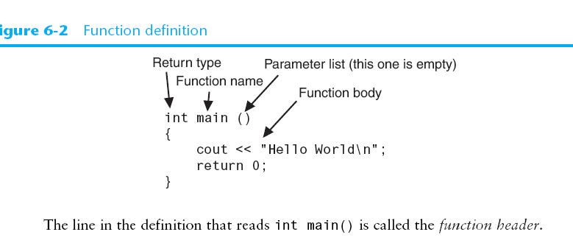
Function Prototype

Slide 26
Function signature and Parameters
Function signature is the combination of the function name and the parameter list.
Variables defined in the function header are known as formal parameters.
When a function is invoked, you pass a value to the parameter. This value is referred to as actual parameter or argument.

Slide 27
Function’s return values
c
A function may return a value:
returnValueType is the data type of the value the function returns.
If function does not return a value, the returnValueType is the keyword void.

Slide 28
void Functions
It isn’t necessary for all functions to return a value,
Some functions simply perform one or more statements, and then terminate.
These are called void functions.
void displayMessage()
{
cout << "Hello from the function displayMessage.\n";
}

Slide 29
Calling Functions
c

Slide 30
Calling Functions
c
i is now 5

Slide 31
Calling Functions
c
j is now 2

Slide 32
Calling Functions
c
Call max(5, 2)

Slide 33
Calling Functions
c
Now num1=5 num2=2

Slide 34
Calling Functions
c
A new variable result will be created (local to the max function)

Slide 35
Calling Functions
c
5 > 2 → true condition

Slide 36
Calling Functions
c
result = 5

Slide 37
Calling Functions
c
return 5

Slide 38
Calling Functions
c
k = 5

Slide 39
Calling Functions
c
Display “The maximum between 5 and 2 is 5”

Slide 40
Calling Functions
c
main function ends

Slide 41
Exercise
Write a function that calculates the person’s Body Mass Index (BMI). The BMI is often used to determine if a person is overweight, underweight for his/her height.
- Ask User to input his/her weight and height
BMI is calculated as:
BMI = (weight * 703) / (height*height)
Here weight is in pounds and height is in inches.
The program should display the message:
- “Optimal Weight” if BMI is 18.5—25
- “Under Weight” if BMI is < 18.5
- “Over Weight” if BMI is > 25

Slide 42
References
Credit goes to Dr. Muhammad Aleem for preparation of slides
Chapter 6, Starting out with c++

Slide 43
Thank You ☺

